Slide 1
ist 263

Slide 2
Agenda
Responsive Web Design

Slide 3
What is RWD?

Slide 4
Making your site look good on:
Desktops
Tablets
Mobile Devices

Slide 5
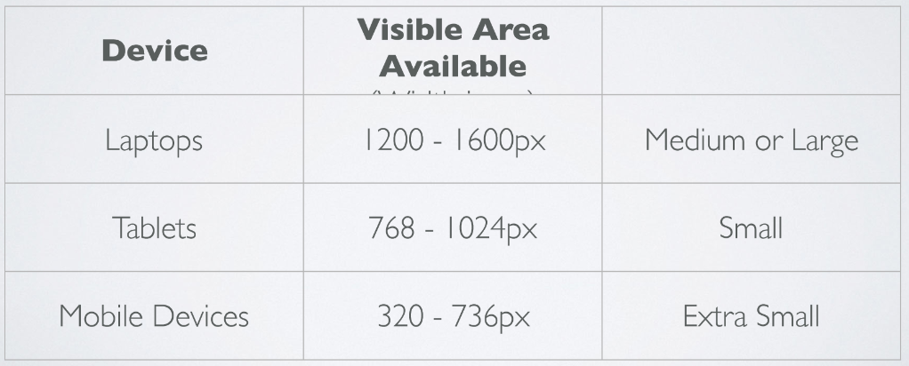
Approximate Device Widths

Slide 6
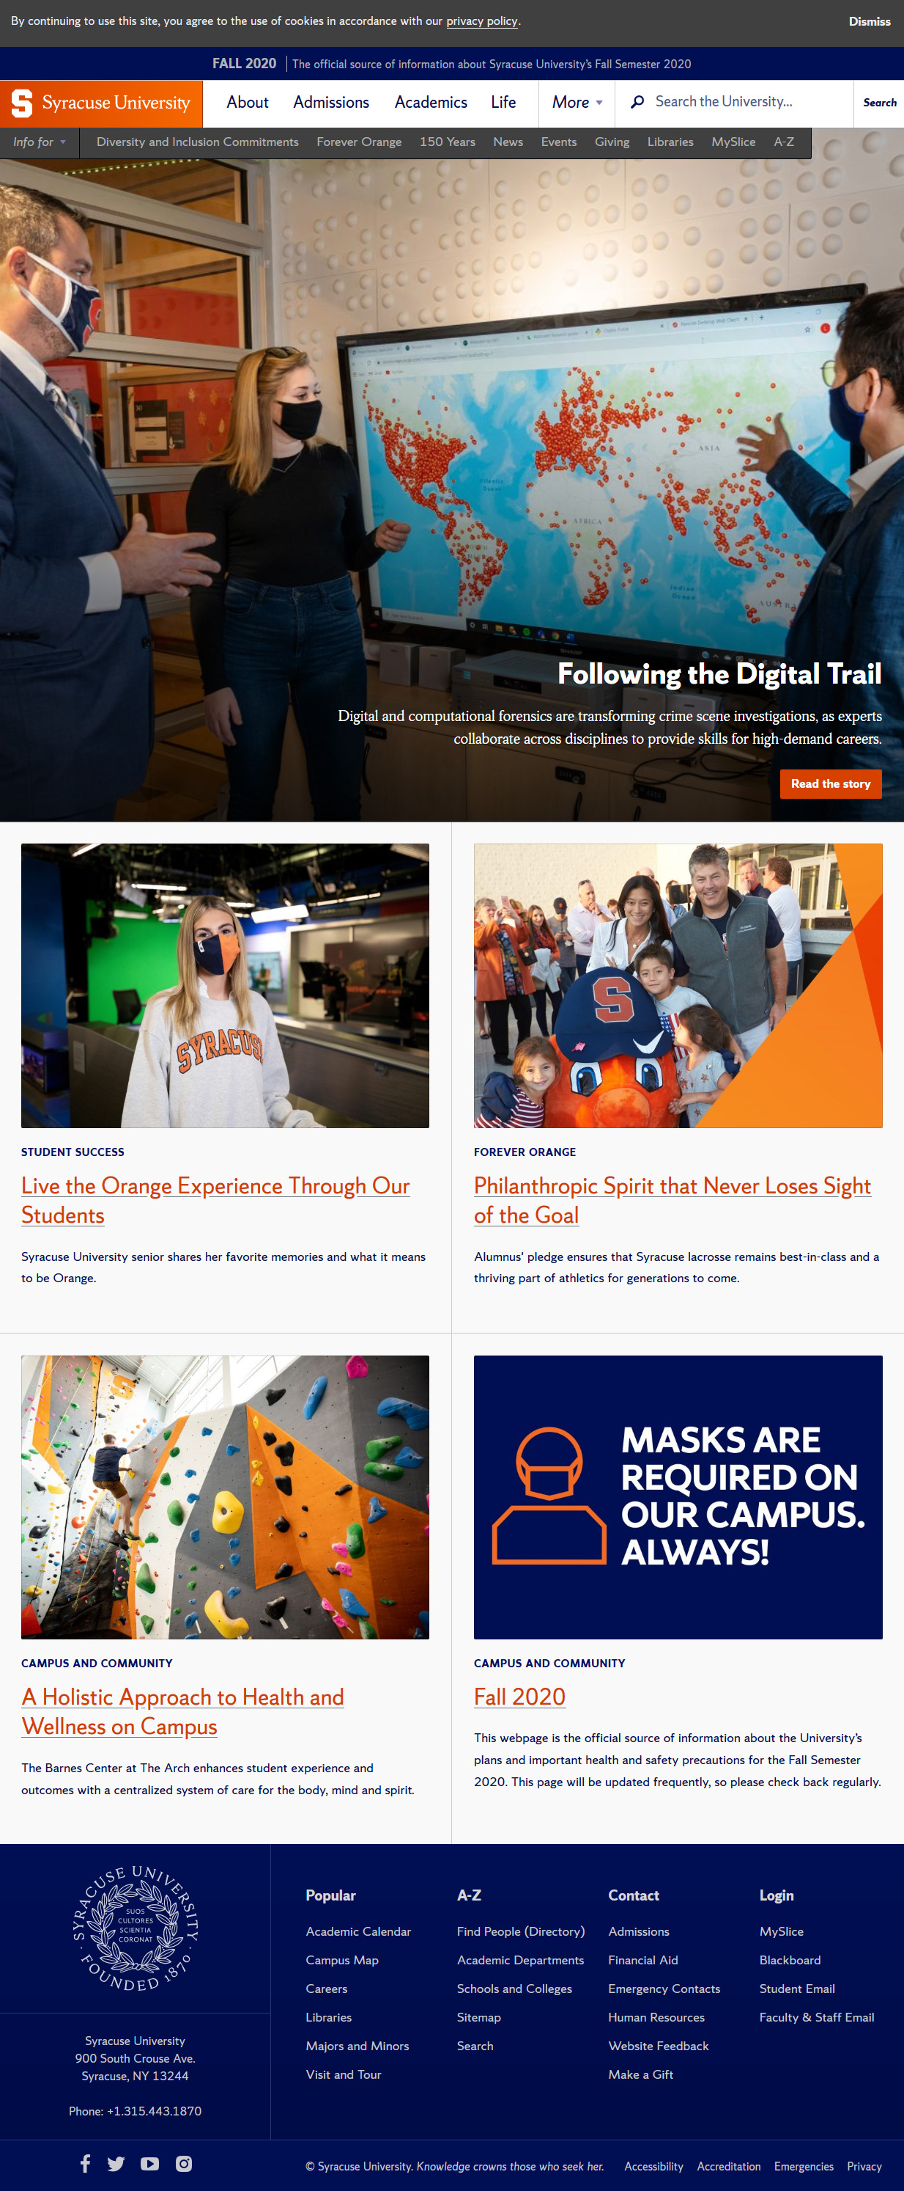
syr.edu
Home Page

Slide 7
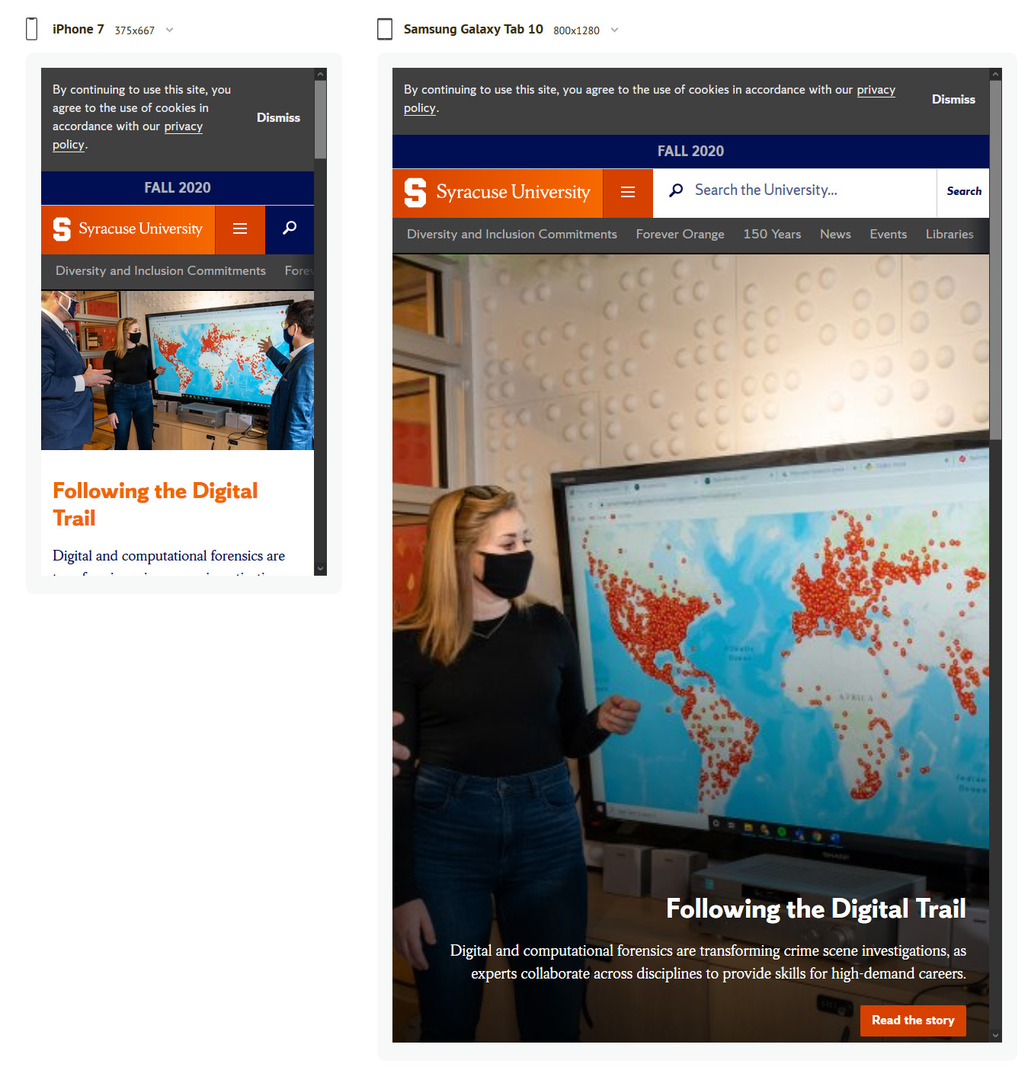
What will we do to size our sites?
Flexible images

Slide 8
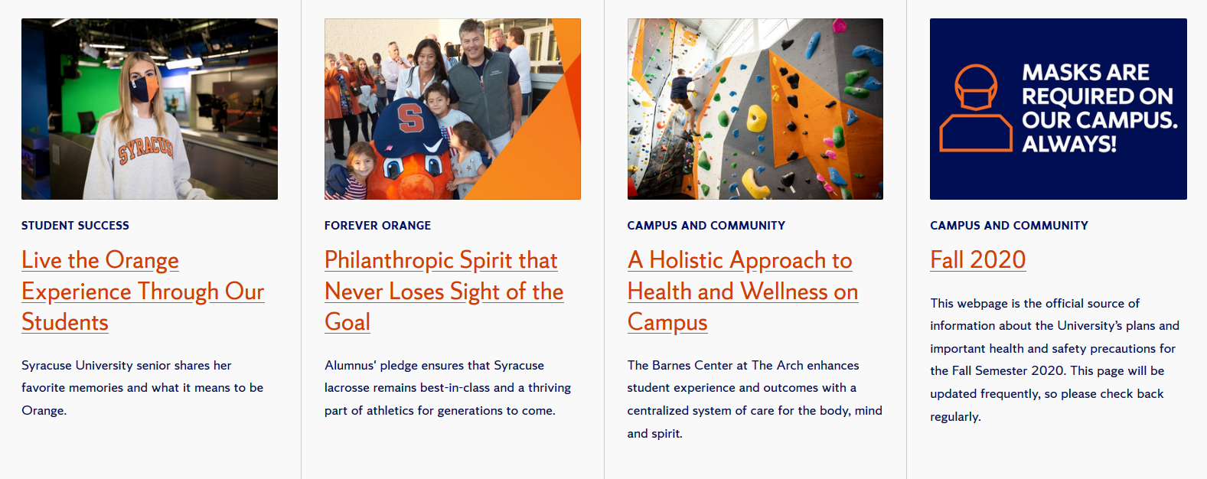
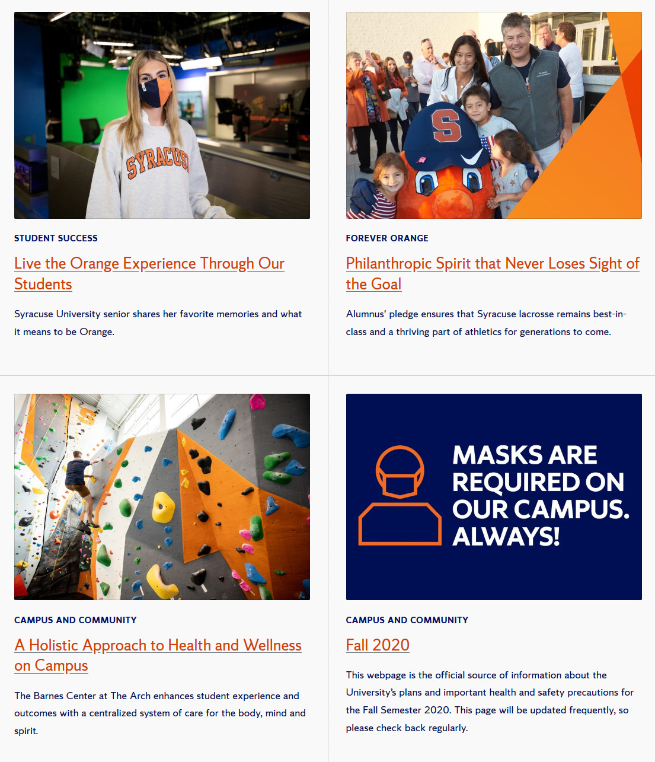
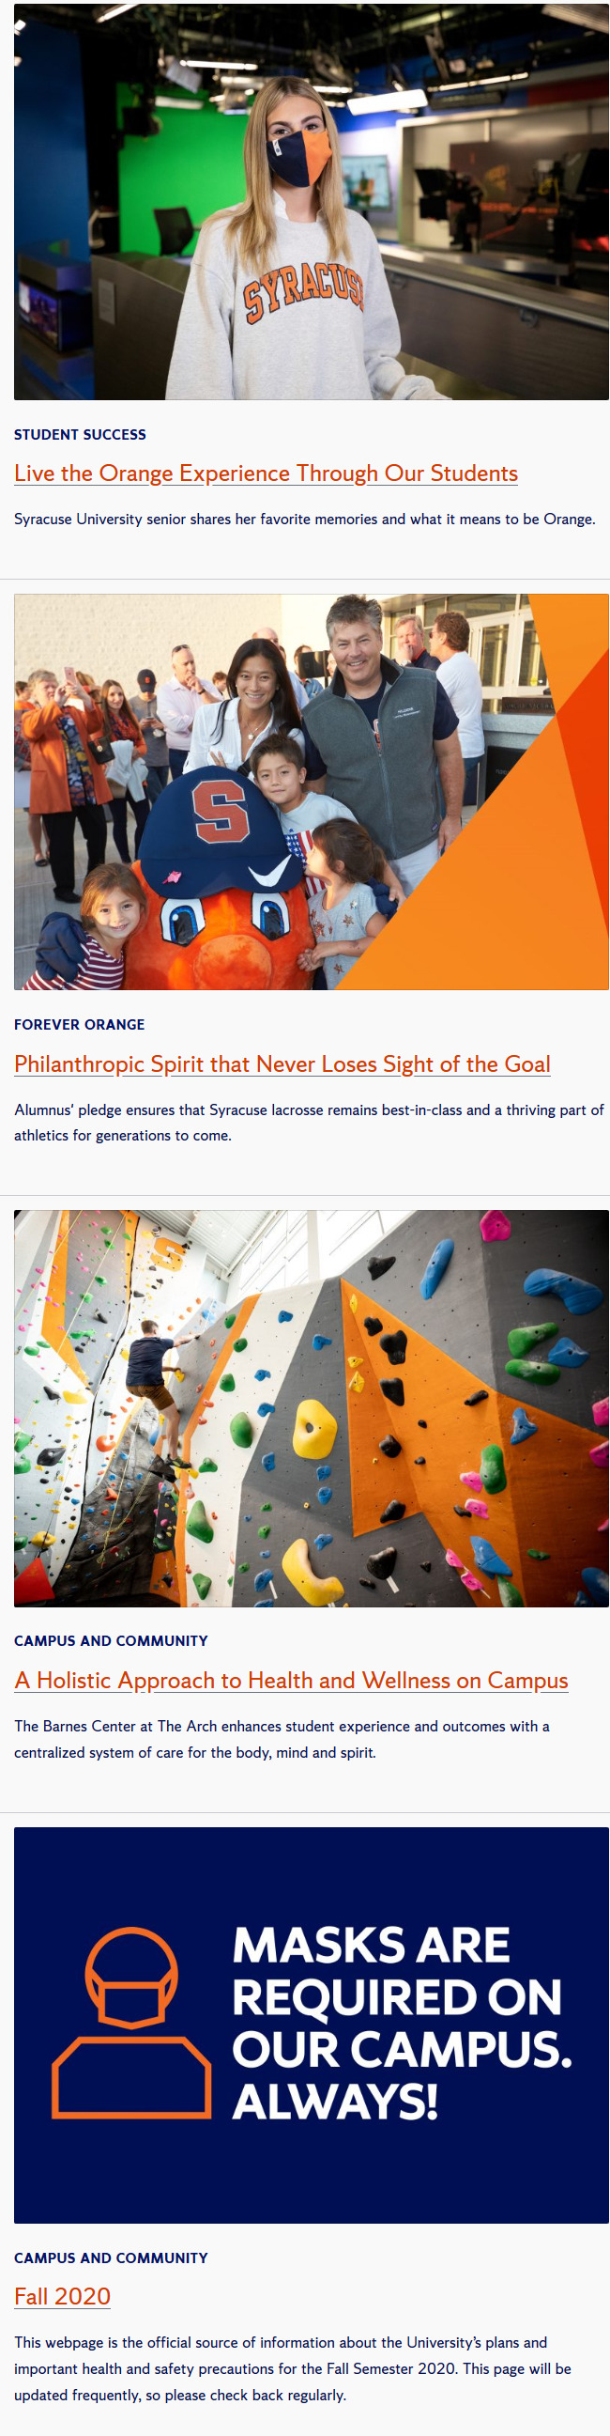
What will we do to size our sites?
Computer
Tablet
Flexible Grids
Cell Phone

Slide 9
What will we do to size our sites?
Media Queries – allow us to give CSS rules strictly by width of screen

Slide 10
viewport

Slide 11
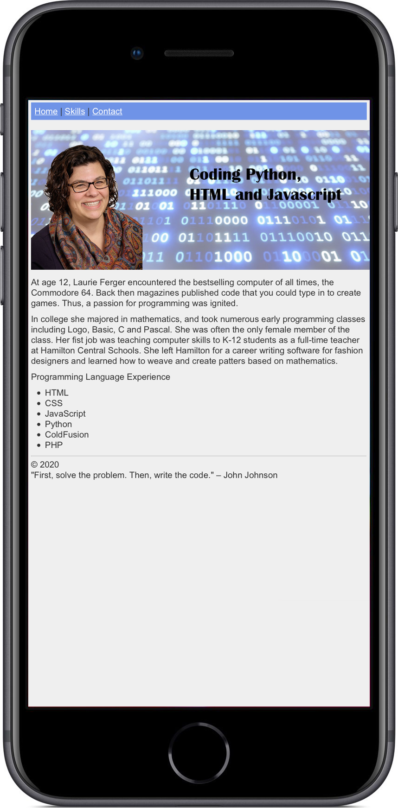
Viewport
The browser's viewport is the area of the window in which web content can be seen. This is often not the same size as the rendered page, in which case the browser provides scrollbars
If you don't control the viewport, you site will shrink to fit the device size. That's when you see a teeny tiny webpage shrunken down to fit your phone screen.

Slide 12
Viewport
<meta name="viewport" content="width=device-width, initial-scale=1.0">
Reminder: meta is a tag that describes information about the data on the page. It goes inside the <head> element.
size of viewport
zoom level

Slide 13
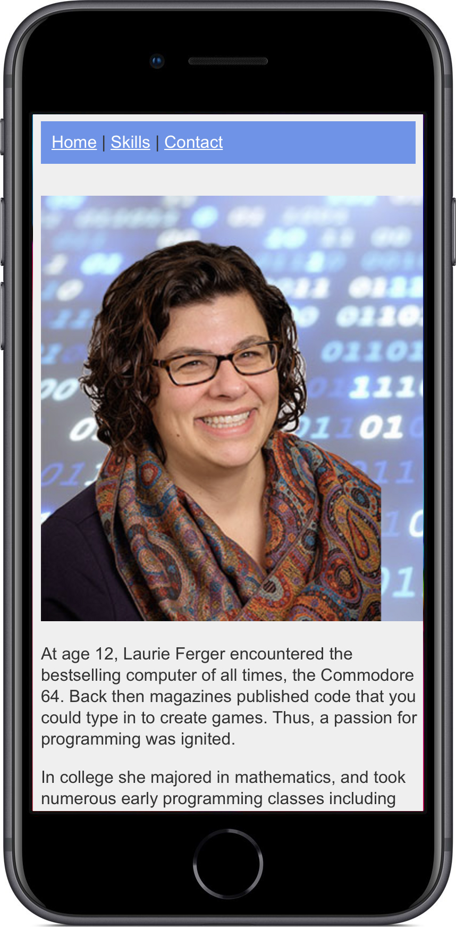
Viewport Meta Tag Display Change

Slide 14
Device viewport simulation

Slide 15


Chrome
Press F12 or right click and go to inspect
Use the dimensions drop down to choose the screen you want to simulate
Firefox
Press F12 or right click and go to inspect
Press the responsive button on the top right
Use the responsive drop down to choose the screen you want to simulate

Slide 16
Flexible Image Sizes

Slide 17
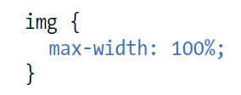
Making Images Flexible

Slide 18
Flexbox wrapping

Slide 19
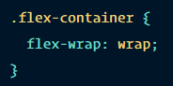
Flexbox Wrapping

Slide 20
Media queries

Slide 21
What is a media query?
Different styles based on…
Width of browser
Orientation of browser
Screen resolution
Whether you are printing or view on screen

Slide 22
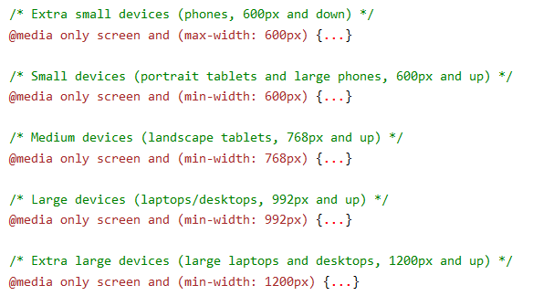
Common Breakpoints

Slide 23
New Display Property Value
display: none;
Used with media queries you can remove an item from the screen, for example at cell phone size.

Slide 24
Participation

Slide 25
Create a web page that says: I’m large.
When the viewport is over 800 pixels.
When the viewport is 800 or less it should say: I’m small.

